Slide 1
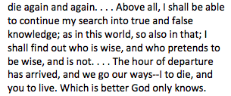
Trial of Socrates
-Plato quoting Socrates, The Trial and Death of Socrates
The passage reflects which following philosophical belief most accurately?
A. That democracy is a dictatorship in disguise.
B. That there is a heaven or a hell.
C. That all men are created equal.
D. That there is a true understanding of right and wrong.

Slide 2
SBMC
2. Which of the following ideological systems is most closely related to the sentiments of the above passage?
A. The Socratic Method
B. Legalism
C. Epicureanism
D. Sophism
3. The last line of the passage reflects which historical truth about the Classical Greek people?
A. That men had more political power than women in Athens.
B. Death was a pathway for greater wisdom.
C. Philosophy and religious beliefs were both important parts of Greek culture.
D. Democracy was the most effective form of government.

Slide 3
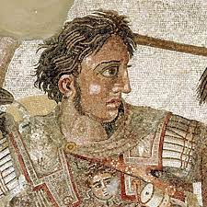
Aim: How is Alexander the Great an example of change and continuity in government and culture for the Classical World?
Do Now: Please consider the following question as it relates to your understanding of history from a “World Perspective”:
Does history make leaders or do leaders make history ?

Slide 4
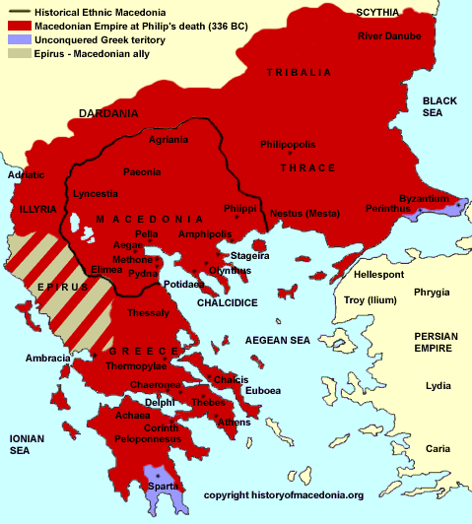
Aim: How is Alexander the Great an Example of Change and Continuity in Government and Culture for the Mediterranean?
Global Context
In the fourth century (400-301) B.C.E., military power in the lands around the Aegean Sea shifted to the kingdom of Macedonia, to the north of Greece. When Philip II became its king in 359 B.C.E., he knew that the Greek city-states were still divided due to the Peloponnesian War between Sparta and Athens, and their continued fighting among themselves had made them weak.
Philip’s armies easily defeated Athens and Thebes in 338 B.C.E. All of the Greek states except Sparta were finally united, but under the control of Macedonia. Philip II had brought all the Greek city-states under his control. His son, Alexander the Great, went on to conquer most of the Mediterranean world – including Persia and Egypt.
How is this a discontinuity in the political leadership of Ancient Greece?

Slide 5
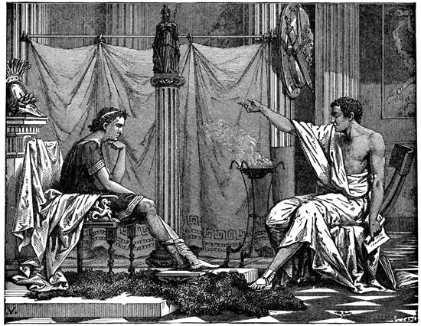
Pair/Share Who was Aristotle? Like Socrates, Aristotle emphasized that every aspect of existence should be subject to study and analysis. Things happened because of rational laws, not because of all powerful deities. Based on our knowledge of Aristotle, how will his philosophies be reflected in the expansion and rule of Alexander the Great?
Aim: How is Alexander the Great an Example of Change and Continuity in Government and Culture for the Mediterranean?
Alexander being tutored by Aristotle

Slide 6
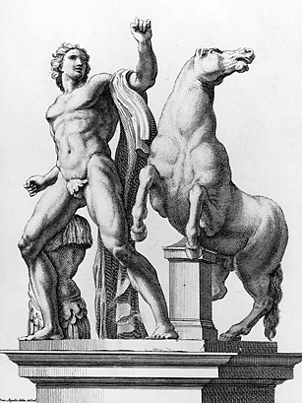
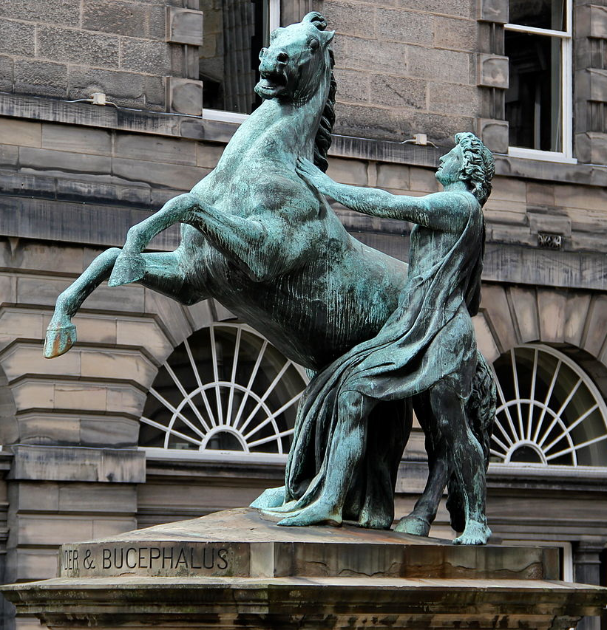
Alexander and his horse Bucephalus
Aim: How is Alexander the Great an Example of Change and Continuity in Government and Culture for the Mediterranean?
Aim: How did Alexander the Great help spread Greek culture?
A statue of Alexander taming Bucephalus

Slide 7
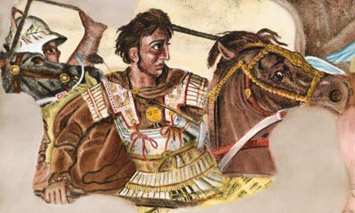
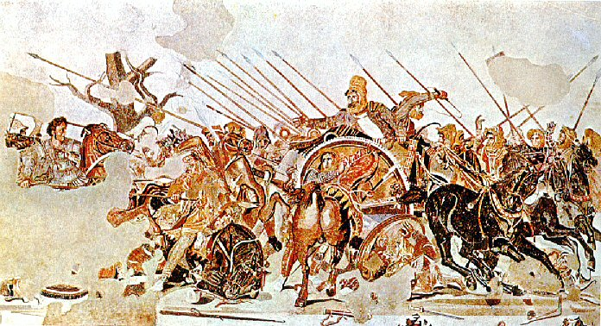
Alexander in Battle 336 B.C.E.-323 B.C.E.
Aim: How is Alexander the Great an Example of Change and Continuity in Government and Culture for the Mediterranean?
Guiding Question: How did Alexander the Great rise to power?
His father Phillip II organized the
Macedonian region into a professional
and paid army.
Use of the phalanx, pike men and
cavalry.
-Alexander was an extremely capable
military general.
-Most historical records indicate that
he may have never lost a battle.
-He had a great education from his
Father and Aristotle.

Slide 8
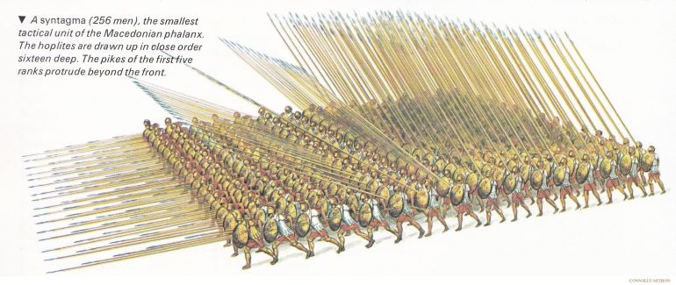
Alexander’s Military Success
Alexander was highly educated in both philosophy and warfare by his father Phillip II and Greek philosopher Aristotle. Alexander excelled at coordinating different military branches—infantry, cavalry, and archers—in a way that maximized their strengths. The Macedonian phalanx (a tightly packed formation of soldiers with long spears called sarissas) was complemented by heavy cavalry (like the Companion Cavalry) which Alexander led personally in battle. His ability to blend these elements, and to direct them with precision on the battlefield, made him highly effective. His famous victory at the Battle of Gaugamela (331 BCE) against the Persian King Darius III is often cited as a textbook example of strategic brilliance, where Alexander used terrain and feigned (fake) retreats to lure the Persian forces into a vulnerable position.

Slide 9
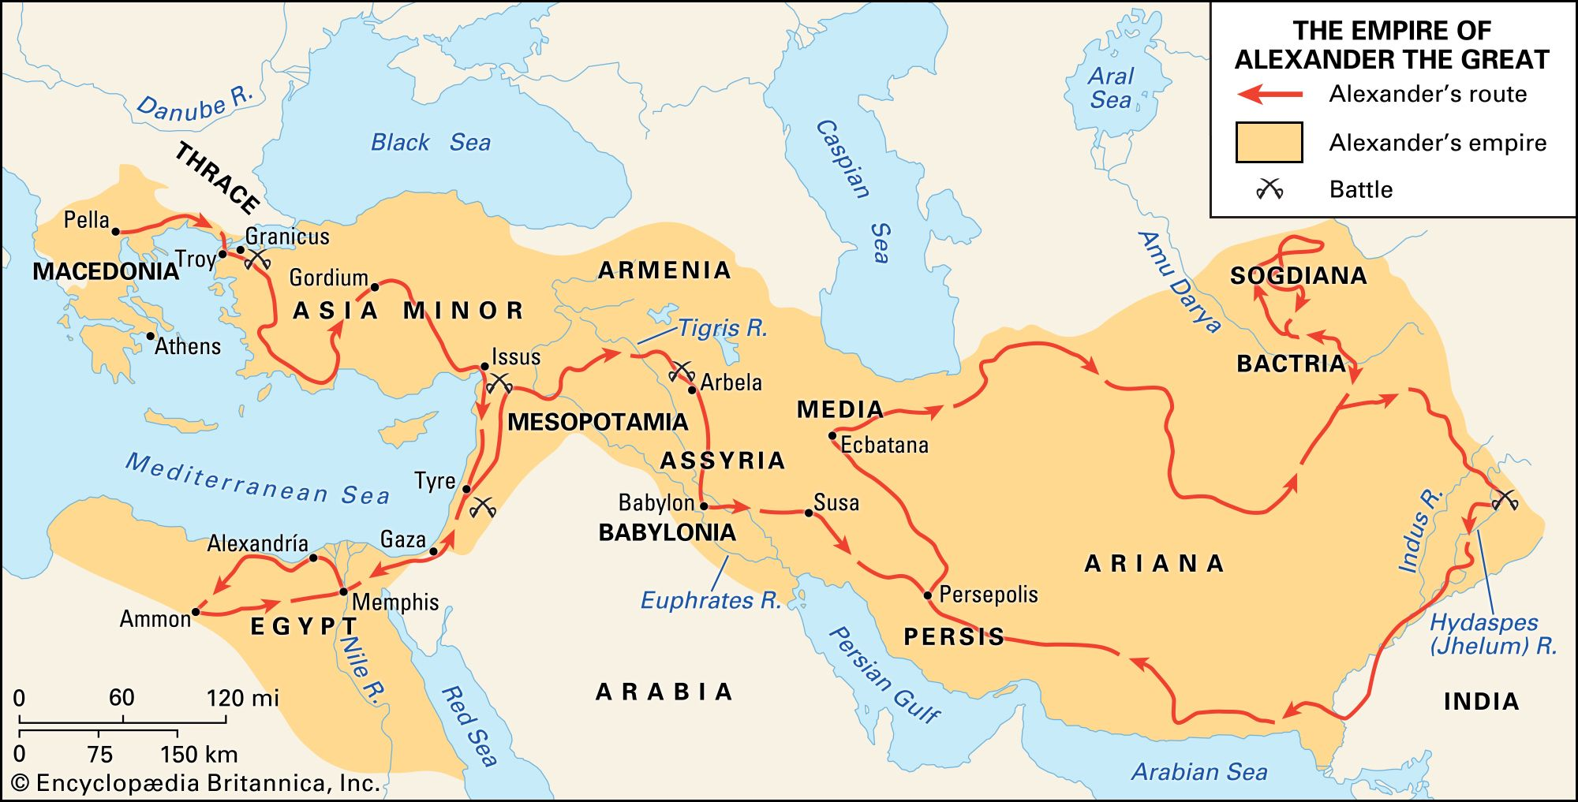
Aim: How is Alexander the Great an Example of Change and Continuity in Government and Culture for the Mediterranean?
Aim:
Conquests of Alexander the Great
Turn and Talk:
According to the map what “empires” did Alexander conquer?
What challenges might “Alexander the Great” face upon his expansion?

Slide 10
Alexander’s Policies:
Aim: How is Alexander the Great an Example of Change and Continuity in Government and Culture for the Mediterranean?
Established key cities along his path of conquest that were settled by veterans of the army and served as administrative headquarters in each region - He named more than 70 cities after himself—and one after his horse.
Attempted to create a unified ruling class of Persians and Greeks by promoting inter-marriages between his leaders and the daughters of local nobles, as well as Greek soldiers marrying local women
Continued the Persian tradition of using Satraps (local governors) to rule over conquered territories within his growing empire
Alexander organized Persian ceremonial events, wore Persian clothing and and married a Persian woman.
Unified his army by placing Persian, Indian, and Egyptian soldiers trained in the Greek phalanx and fighting skills in Macedonian ranks
So what?! What is significant (the analysis) about this information?

Slide 11
Crash Course Video
2:00-5:50
https://www.youtube.com/watch?v=0LsrkWDCvxg

